Slide 1
CARTOONIFY
PANCHAMI.P.M
MES20MCA-2038
PRODUCT OWNER-Mr BALACHANDRAN K P

Slide 2
TABLE OF CONTENTS
Introduction
Objectives
Modules
Methodology
Developing Environment
User Stories
Product Backlog
Project Plan
Sprint Backlog
Sprint Actual

Slide 3
INTRODUCTION
Advanced technology has become the integral part of our life . The image processing plays a major role in all computers related applications. The image processing appears in many real-life applications, e.g., home security, banking system, education sector, defense system, Railway, and so on. Almost all people are left with very precious and unforgettable memories of our childhood. So today let’s head towards giving our pictures some cartoonic effects. Thus, I am going to build a python application that will transform an image into its cartoon using OpenCV. To convert an image to a cartoon, multiple transformations are done. Firstly, an image is converted to a Grayscale image. Then, the Grayscale image is smoothened, and try to extract the edges in the image. Finally, form a color image and mask it with edges. This creates a beautiful cartoon image with edges and lightened color of the original image.

Slide 4
OBJECTIVE
Rapid image processing technique with high detection rates.
To provide High accuracy model which is precise as compare to current existing models.
To provide possibly low false positive rate.
Other apps are difficult to use as user has to markdown points & lines on the image to apply effects which is not user friendly also the options are limited.

Slide 5
MODULES
1.Importing the required libraries
2. Building a File Box to choose a particular file
3.Creating Buttons
4. Transforming an image to gray scale
5. Smoothening a gray scale image
6. Retrieving the edges of an image
7. Preparing a Mask Image
8. Giving a Cartoon Effect
9. Plotting all the transitions together
10. Building save button

Slide 6
METHODOLOGY
OpenCV is a python library used for real-time computer vision applications. OpenCV is open source and has huge applications in Image Processing, Machine Learning and Deep Learning. OpenCV can be used for object detection, classification, handwriting analysis and much more. Many apps and websites provide tools to give a cartoon effect to our images. Young generations like this feature and it is very popular over social media as well. In the case of these apps, we just upload our image and an image with the desired effects are returned to us.
To convert an image into cartoon multiple transformations are needed.

Slide 7
Transforming an image to gray scale
Smoothening a gray scale image
BLOCK DIAGRAM
Retrieving the edges of an image
Plotting all the transitions together
. Giving a Cartoon Effect
Preparing a Mask Image

Slide 8
The first step is to import the required libraries.
CV2: Imported to use OpenCV for image processing
easygui: Imported to open a file box. It allows us to select any file from our system.
Numpy: Images are stored and processed as numbers. These are taken as arrays. We use NumPy to deal with arrays.
Imageio: Used to read the file which is chosen by file box using a path.
Matplotlib: This library is used for visualization and plotting. Thus, it is imported to form the plot of images.
OS: For OS interaction. Here, to read the path and save images to that path.
The second step is to create the main window of the application. So I am going to Build a File Box to choose a particular file. In this file box I added some button named ‘Cartoonify an Image’ and Camera and at last a Save button.
Now, all the operation will be done on the button click. When I click on the button it opens File Explorer, from which I can select an image. Otherwise I can choose the camera option which directly capture the image and also using this web application the image will turns into a cartoon image. After selecting the image, the image is stored as a numpy array.

Slide 9
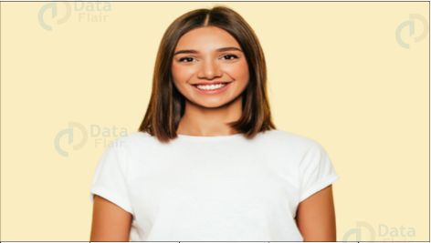
Imread is a method in cv2 which is used to store images in the form of numbers. The image is read as a numpy array, in which cell values depict R, G, and B values of a pixel.
The image will be resized after each transformation to display all images on the same scale.
Next step is, Transforming an image to grayscale.
cvtColor(image, flag) is a method in cv2 which is used to transform an image into the color-space mentioned as ‘flag’. BGR2GRAY flag can be used to convert an image to grayscale. This returns the image in grayscale.
Original Image

Slide 10
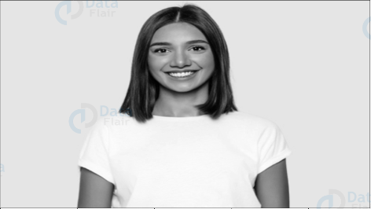
Gray Scale Image

Slide 11
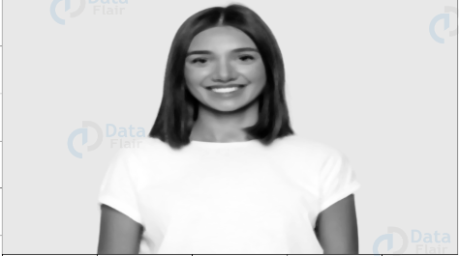
Next step is, Smoothening a grayscale image.
To smoothen an image, we simply apply a blur effect. This is done using medianBlur() function. Here, the center pixel is assigned a mean value of all the pixels which fall under the kernel. It also helps to remove noise in the image.

Slide 12
Next is, Retrieving the edges of an image.
Here, we will try to retrieve the edges and highlight them. This is attained by the adaptive thresholding technique.
Thresholding is a type of image segmentation, where we change the pixels of an image to make the image easier to analyze. In thresholding, The goal is to create a binary representation of the image, classifying each pixel into one of two categories, such as “dark” or “light”.
ADAPTIVE THRESHOLDING
It is a method where the threshold value is calculated for the smaller regions. There will be different threshold value for different regions.
It is used when different lighting conditions are varies from point to point of an image.
It gives better results of images with various illuminations.
Syntax:
cv.adaptiveThreshold (source, max_value, adaptive_method, threshold_type, blocksize, value of c)
cv2.adaptiveThreshold(smoothGrayScale, 255, cv2.ADAPTIVE_THRESH_MEAN_C, cv2.THRESH_BINARY, 9, 9)
Adaptive method is two types;
ADAPTIVE_THRESH_MEAN_C − threshold value is the mean of neighborhood area.
ADAPTIVE_THRESH_GAUSSIAN_C − threshold value is the weighted sum of neighborhood values where weights are a Gaussian window.

Slide 13
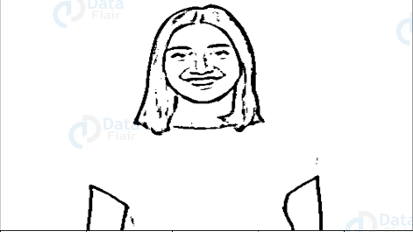
Cartoon effect has two specialties:
1. Highlighted Edges
2. Smooth colors
In this step, will work on the first specialty. Here, will try to retrieve the edges and highlight them. This is attained by the adaptive thresholding technique. The threshold value is the mean of the neighborhood pixel values area minus the constant C. C is a constant that is subtracted from the mean or weighted sum of the neighborhood pixels. Thresh_binary is the type of threshold applied, and the remaining parameters determine the block size.

Slide 14
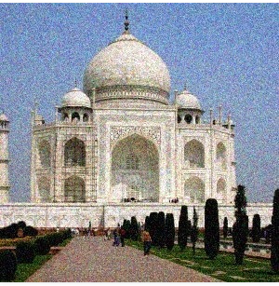
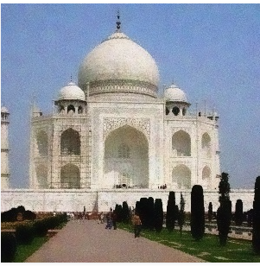
Preparing MASK image.
Now I am going to work on the second speciality. Preparing a lightened color image that will mask with edges at the end to produce a cartoon image. Here bilateralFilter used to removes the noise.
A bilateral filter is used for smoothening images and reducing noise, while preserving edges.
It can be taken as smoothening of an image to an extent.

Slide 15
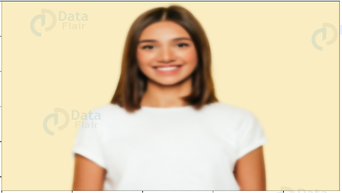
Here some parameters are used to define the sigma space and color similar to the AI ​​effects in modern mobile phones.

Slide 16
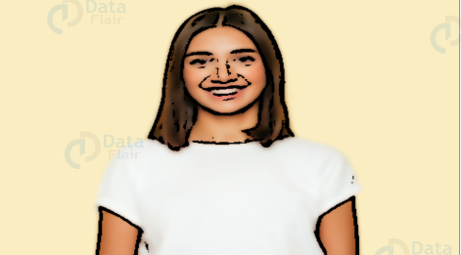
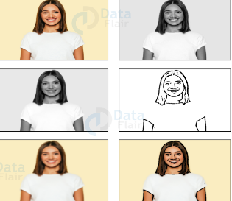
So the final step is to give the cartoon effect to a image.
The final task is done by masking where here perform bit wise and on the highlighted edges and the smooth colors. With this will get a cartoon image. At last plotting all the transitions together and also adding a save button on the main window to download the image.

Slide 17
DEVELOPING ENVIRONMENT
Hardware Requirements
Input Device : Mouse, Keyboard
Output Device : Monitor
Memory : 4 Gb Ram(Minimum)
Processor : Intel core i3 or above
Software Requirements
Operating System : Windows 8 /10 for Better Performance
Front End : Python
Software Used : Pycharm
Web Browser :Internet Explorer/Google Chrome/Firefox(for web application)

Slide 18
USER STORIES
User Story ID | As a <type of user> | I want to | So that I can
1 | Admin | Import the required libraries | Perform specific functions for this project.
2 | Admin | Design the main window | Build a File box
3 | Admin | Build a File Box | Add buttons
4 | Admin | Create Buttons | Open the file explorer and choose a particular file
5 | Admin | Implement BGR2GRAY flag | Transform image into gray scale
6 | Admin | Apply the blur effect | Smoothen a gray scale image

Slide 19
USER STORIES
User Story ID | As a <type of user> | I want to | So that I can
7 | Admin | Highlight the edges of the image | identify the particular object from the image
8 | Admin | preparing a lightened color image | produce a cartoon image
9 | Admin | mask the image | Cartoonify the image
10 | Admin | Plot all the transitions together | display one-one images in each block
11 | Admin | Adding a save button | save the resultant image

Slide 20
PROJECT PLAN
User Story ID | Task Name | Start Date | End Date | Hours | Status
1 | Sprint 1 | 20/04/2022 | 21/04/2022 | 1 | Completed
2 |  | 26/04/2022 | 28/04/2022 | 2 | Completed
3 |  | 03/05/2022 | 05/05/2022 | 2 | Completed
4 | Sprint 2 | 10/05/2022 | 12/05/2022 | 1 | Completed
5 |  | 17/05/2022 | 19/05/2022 | 3 | Completed
6 |  | 24/05/2022 | 26/05/2022 | 2 | Completed
7 | Sprint 3 | 01/06/2022 | 02/06/2022 | 2 | Completed
8 |  | 03/06/2022 | 05/06/2022 | 2 | Completed
9 |  | 06/06/2022 | 07/06/2022 | 3 | Completed
10 | Sprint 4 | 20/06/2022 | 25/06/2022 | 2 | Completed
11 |  | 05/04/2022 | 06/07/2022 | 3 | Completed

Slide 21
PRODUCT BACKLOG
User Story ID | Priority <High/Medium/Low> | Size (Hours) | Sprint <#> | Status <Planned/In progress/Completed> | Release Date | Release Goal
1 | Low | 1 | Sprint 1 | Completed | 21/04/2022 | Importing libraries
2 | Medium | 2 |  |  | 28/04/2022 | Building main window
3 | Medium | 2 |  |  | 05/05/2022 | Designing File Box
4 | Low | 1 | Sprint 2 | Completed | 12/05/2022 | Selecting an image
5 | High | 3 |  |  | 19/05/2022 | Transform image into grayscale
6 | Medium | 2 |  |  | 26/05/2022 | Smoothening the grayscale image

Slide 22
User Story ID | Priority <High/Medium/Low> | Size (Hours) | Sprint <#> | Status <Planned/In progress/Completed> | Release Date | Release Goal
7 | Medium | 2 | Sprint 3 | Completed | 02/06/2022 | Highlighting edges
8 | Medium | 2 |  |  | 05/06/2022 | Preparing lightened color image
9 | High | 3 |  |  | 07/06/2022 | Masking and cartoonify image
10 | Medium | 2 | Sprint 4 | Completed | 25/06/2022 | Plotting transitions
11 | Medium | 3 |  |  | 06/07/2022 | Saving image

Slide 23
SPRINT BACKLOG PLAN-SPRINT1
Backlog Item | Status & completion date | Original estimate in hours | Day1 | Day2 | Day3 | Day4 | Day5 | Day6 | Day7 | Day8 | Day9 | Day10 | Day11 | Day12 | Day13 | Day14
User story #1,2,3 |  | hrs | hrs | hrs | hrs | hrs | hrs | hrs | hrs | hrs | hrs | hrs | hrs | hrs | hrs | hrs
Importing libraries | 21/04/2022 | 1 | 1 | 0 | 0 | 0 | 0 | 0 | 0 | 0 | 0 | 0 | 0 | 0 | 0 | 0
Building main window | 28/04/2022 | 2 | 1 | 1 | 0 | 0 | 0 | 0 | 0 | 0 | 0 | 0 | 0 | 0 | 0 | 0
Designing File Box | 05/05/2022 | 2 | 0 | 0 | 1 | 1 | 0 | 0 | 0 | 0 | 0 | 0 | 0 | 0 | 0 | 0
Total |  | 5 | 2 | 1 | 1 | 1 | 0 | 0 | 0 | 0 | 0 | 0 | 0 | 0 | 0 | 0

Slide 24
SPRINT2
Backlog Item | Status & completion date | Original estimate in hours | Day1 | Day2 | Day3 | Day4 | Day5 | Day6 | Day7 | Day8 | Day9 | Day10 | Day11 | Day12 | Day13 | Day14
User story #4,5,6 |  | hrs | hrs | hrs | hrs | hrs | hrs | hrs | hrs | hrs | hrs | hrs | hrs | hrs | hrs | hrs
Selecting an image | 12/05/2022 | 1 | 1 | 0 | 0 | 0 | 0 | 0 | 0 | 0 | 0 | 0 | 0 | 0 | 0 | 0
Transform image into grayscale | 19/05/2022 | 3 | 1 | 1 | 0 | 1 | 0 | 0 | 0 | 0 | 0 | 0 | 0 | 0 | 0 | 0
Smoothening the grayscale image | 26/05/2022 | 2 | 0 | 0 | 2 | 0 | 0 | 0 | 0 | 0 | 0 | 0 | 0 | 0 | 0 | 0
Total |  | 6 | 2 | 1 | 2 | 1 | 0 | 0 | 0 | 1 | 0 | 0 | 0 | 0 | 0 | 0

Slide 25
SPRINT3
Backlog Item | Status & completion date | Original estimate in hours | Day1 | Day2 | Day3 | Day4 | Day5 | Day6 | Day7 | Day8 | Day9 | Day10 | Day11 | Day12 | Day13 | Day14
User story #7,8,9 |  | hrs | hrs | hrs | hrs | hrs | hrs | hrs | hrs | hrs | hrs | hrs | hrs | hrs | hrs | hrs
Highlighting edges | 02/06/2022 | 2 | 1 | 0 | 1 | 0 | 0 | 0 | 0 | 0 | 0 | 0 | 0 | 0 | 0 | 0
Preparing lightened color image | 05/06/2022 | 2 | 1 | 0 | 0 | 0 | 0 | 0 | 0 | 1 | 0 | 0 | 0 | 0 | 0 | 0
Masking and cartoonify image | 07/06/2022 | 3 | 1 | 0 | 0 | 1 | 0 | 0 | 0 | 1 | 0 | 0 | 0 | 0 | 0 | 0
Total |  | 7 | 3 | 0 | 1 | 1 | 0 | 0 | 0 | 2 | 0 | 0 | 0 | 0 | 0 | 0

Slide 26
SPRINT4
Backlog Item | Status & completion date | Original estimate in hours | Day1 | Day2 | Day3 | Day4 | Day5 | Day6 | Day7 | Day8 | Day9 | Day10 | Day11 | Day12 | Day13 | Day14
User story #10,11 |  | hrs | hrs | hrs | hrs | hrs | hrs | hrs | hrs | hrs | hrs | hrs | hrs | hrs | hrs | hrs
Plotting transitions together | 25/06/2022 | 2 | 1 | 0 | 1 | 0 | 0 | 0 | 0 | 0 | 0 | 0 | 0 | 0 | 0 | 0
Save image | 06/07/2022 | 3 | 1 | 0 | 0 | 1 | 0 | 0 | 0 | 1 | 0 | 0 | 0 | 0 | 0 | 0
Total |  | 5 | 2 | 0 | 1 | 1 | 0 | 0 | 0 | 1 | 0 | 0 | 0 | 0 | 0 | 0

Slide 27
SPRINT ACTUAL-SPRINT1
Backlog Item | Status & completion date | Original estimate in hours | Day1 2/3 | Day2 3/3 | Day3 4/3 | Day4 5/3 | Day5 6/3 | Day6 7/3 | Day7 8/3 | Day8 9/3 | Day9 10/3 | Day10 11/3 | Day11 12/3 | Day12 13/3 | Day13 14/3 | Day14 15/3 | Completed(Y/N)
User story #1,2,3 |  | hrs | hrs | hrs | hrs | hrs | hrs | hrs | hrs | hrs | hrs | hrs | hrs | hrs | hrs | hrs
Importing libraries | 12/05/2022 | 1 | 1 | 0 | 0 | 0 | 0 | 0 | 0 | 0 | 0 | 0 | 0 | 0 | 0 | 0 | Y
Building main window | 19/05/2022 | 3 | 1 | 1 | 0 | 1 | 0 | 0 | 0 | 0 | 0 | 0 | 0 | 0 | 0 | 0 | Y
Designing File Box | 26/05/2022 | 2 | 0 | 0 | 2 | 0 | 0 | 0 | 0 | 0 | 0 | 0 | 0 | 0 | 0 | 0 | Y
Total |  | 6 | 2 | 1 | 2 | 1 | 0 | 0 | 0 | 1 | 0 | 0 | 0 | 0 | 0 | 0 | Y

Slide 28
SPRINT ACTUAL-SPRINT2
Backlog Item | Status & completion date | Original estimate in hours | Day1 2/3 | Day2 3/3 | Day3 4/3 | Day4 5/3 | Day5 6/3 | Day6 7/3 | Day7 8/3 | Day8 9/3 | Day9 10/3 | Day10 11/3 | Day11 12/3 | Day12 13/3 | Day13 14/3 | Day14 15/3 | Completed(Y/N)
User story #4,5,6 |  | hrs | hrs | hrs | hrs | hrs | hrs | hrs | hrs | hrs | hrs | hrs | hrs | hrs | hrs | hrs
Selecting an image | 21/04/2022 | 1 | 1 | 0 | 0 | 0 | 0 | 0 | 0 | 0 | 0 | 0 | 0 | 0 | 0 | 0 | Y
Transform image into grayscale | 28/04/2022 | 2 | 1 | 1 | 0 | 0 | 0 | 0 | 0 | 0 | 0 | 0 | 0 | 0 | 0 | 0 | Y
Smoothening the grayscale image | 05/05/2022 | 2 | 0 | 0 | 1 | 1 | 0 | 0 | 0 | 0 | 0 | 0 | 0 | 0 | 0 | 0 | Y
Total |  | 5 | 2 | 1 | 1 | 1 | 0 | 0 | 0 | 0 | 0 | 0 | 0 | 0 | 0 | 0 | Y

Slide 29
SPRINT ACTUAL-SPRINT3
Backlog Item | Status & completion date | Original estimate in hours | Day1 2/3 | Day2 3/3 | Day3 4/3 | Day4 5/3 | Day5 6/3 | Day6 7/3 | Day7 8/3 | Day8 9/3 | Day9 10/3 | Day10 11/3 | Day11 12/3 | Day12 13/3 | Day13 14/3 | Day14 15/3 | Completed(Y/N)
User story #7,8,9 |  | hrs | hrs | hrs | hrs | hrs | hrs | hrs | hrs | hrs | hrs | hrs | hrs | hrs | hrs | hrs
Highlighting edges | 02/06/2022 | 2 | 1 | 0 | 1 | 0 | 0 | 0 | 0 | 0 | 0 | 0 | 0 | 0 | 0 | 0 | Y
Preparing lightened color image | 05/06/2022 | 2 | 1 | 0 | 0 | 0 | 0 | 0 | 0 | 1 | 0 | 0 | 0 | 0 | 0 | 0 | Y
Masking and cartoonify image | 07/06/2022 | 3 | 1 | 0 | 0 | 1 | 0 | 0 | 0 | 1 | 0 | 0 | 0 | 0 | 0 | 0 | Y
Total |  | 7 | 3 | 0 | 1 | 1 | 0 | 0 | 0 | 2 | 0 | 0 | 0 | 0 | 0 | 0 | Y

Slide 30
SPRINT ACTUAL-SPRINT4
Backlog Item | Status & completion date | Original estimate in hours | Day1 2/3 | Day2 3/3 | Day3 4/3 | Day4 5/3 | Day5 6/3 | Day6 7/3 | Day7 8/3 | Day8 9/3 | Day9 10/3 | Day10 11/3 | Day11 12/3 | Day12 13/3 | Day13 14/3 | Day14 15/3 | Completed(Y/N)
User story #10,11 |  | hrs | hrs | hrs | hrs | hrs | hrs | hrs | hrs | hrs | hrs | hrs | hrs | hrs | hrs | hrs
Plotting transitions together | 25/06/2022 | 2 | 1 | 0 | 1 | 0 | 0 | 0 | 0 | 0 | 0 | 0 | 0 | 0 | 0 | 0 | Y
Save image | 06/07/2022 | 3 | 1 | 0 | 0 | 1 | 0 | 0 | 0 | 1 | 0 | 0 | 0 | 0 | 0 | 0 | Y
Total |  | 5 | 2 | 0 | 1 | 1 | 0 | 0 | 0 | 1 | 0 | 0 | 0 | 0 | 0 | 0

